Slide 2
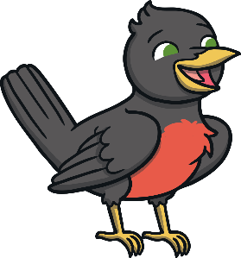
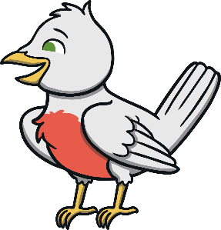
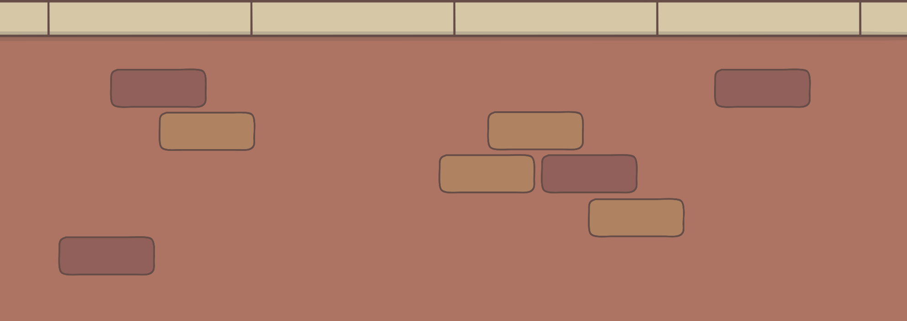
Two little dickie birds
sitting on a wall.

Slide 3
One named Peter,
one named Paul.

Slide 4
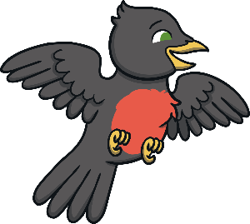
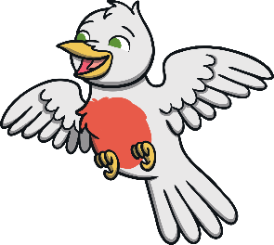
Fly away Peter,
fly away Paul.

Slide 5


Come back Peter,
come back Paul.

