Slide 1
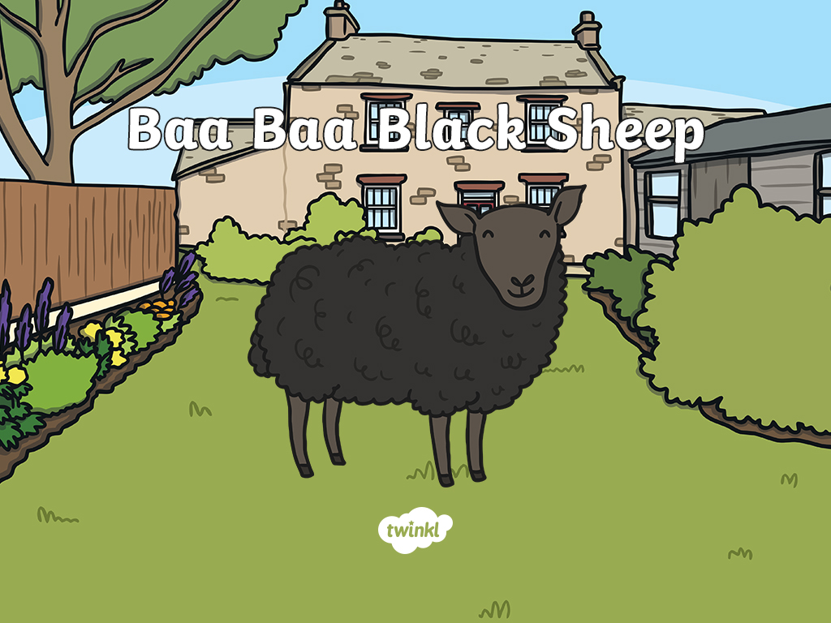

Slide 2
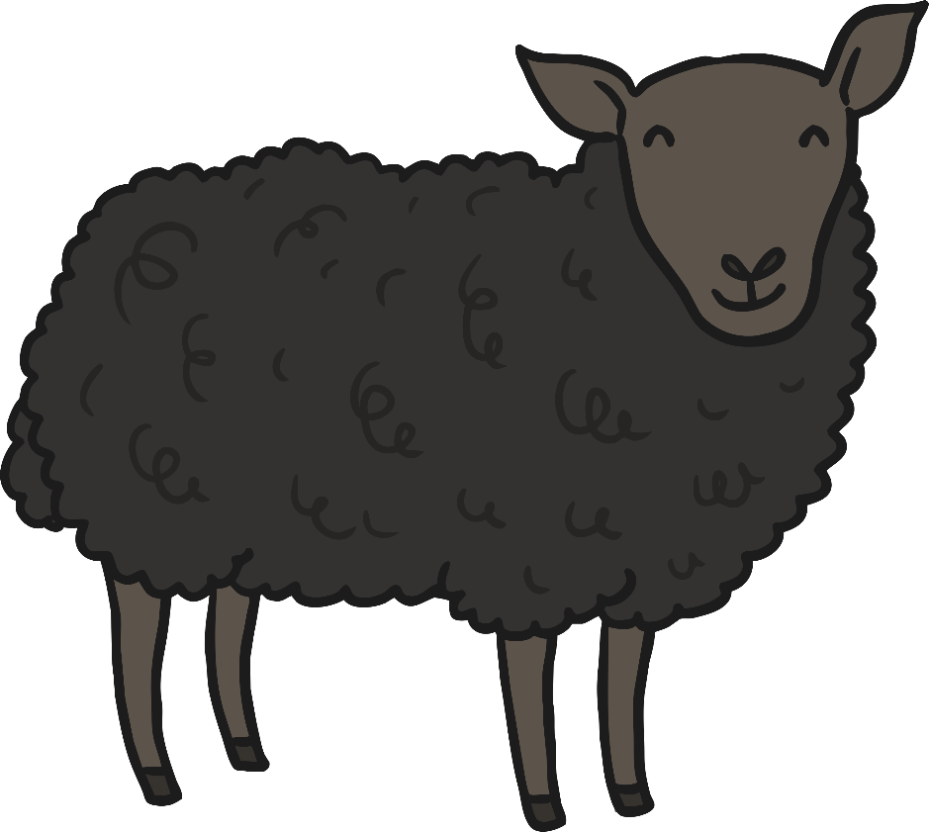
Baa baa black sheep, have you any wool?

Slide 3
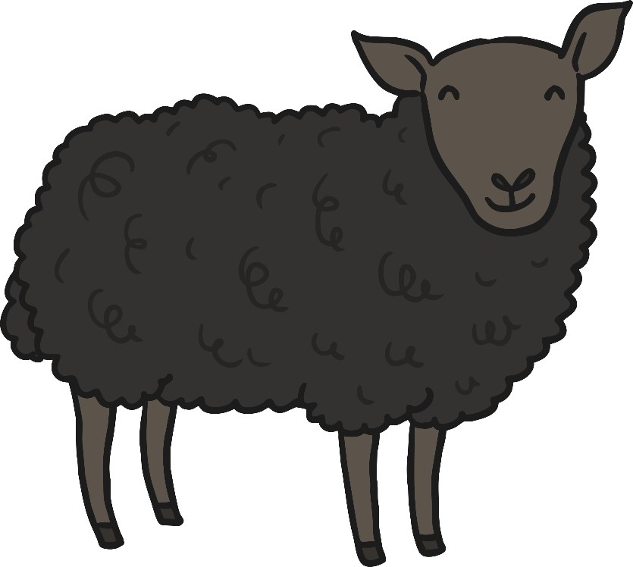

“Yes sir, yes sir, three bags full!”

Slide 4
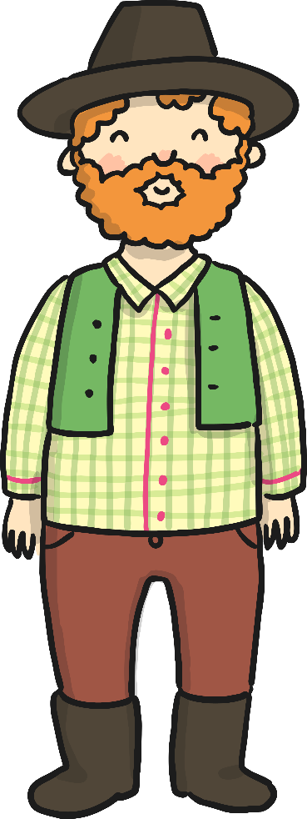

One for the master…

Slide 5
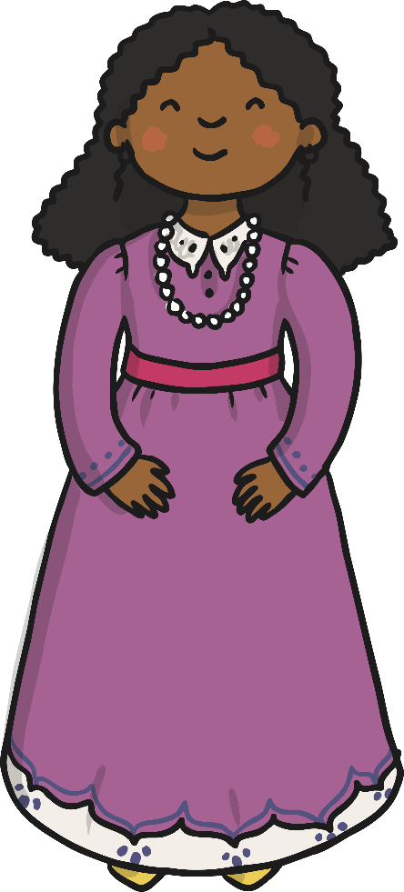
One for the Dame…

Slide 6
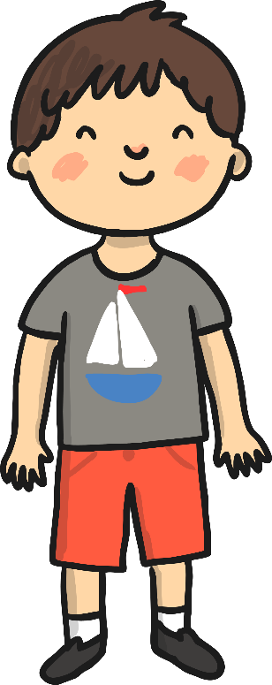
And one for the little boy who lives down the lane.

Slide 7


